Slide 1
The Right to Counsel for Parents in Family Court: An Exploratory Investigation of State Policies
Alissa Pollitz Worden, University at Albany SUNY
Andrew Lucas Blaize Davies, NY State Office of Indigent Legal Services
Angela Burton, NY State Office of Indigent Legal Services
Amy Hudson, University at Albany SUNY
Prepared for presentation at the 2012 meeting of the American Society of Criminology, November 21 in San Francisco, California.

Slide 2
Access to Counsel for Parents in Family Cases
The case for counsel:
The promise and potential: equal standing in the courts
Precedents in criminal court standards?
Implications of policies for economic and social equality
American Bar Association resolution
Barriers to access:
Federalism
Lassiter v. Dept of Social Services (1981) – the Anti-Gideon
Statutory provisions vs. formalized legal rights
Costs of legal representation in family matters

Slide 3
Research Questions
How extensive are parents’ rights to counsel in family court matters?
How do states vary in their mix of granting counsel?
What might account for variability across state policies?
What are the implications of broader entitlement to counsel for caseload and costs? --- a case study of upstate New York

Slide 4
Variability in State Policies and Practices
Variation in the strength of the ‘right’ to counsel
Statutes vs. court rulings and rights
Right or privilege? categorical, qualified, and discretionary assignment
Variation in the reach of access to counsel
Termination of parental rights Abuse, neglect, dependency
Civil contempt Paternity
Domestic violence Orders of protection
Custody disputes Divorce

Slide 5
Mapping the Right To Counsel In Family Law Cases
Laura Abel & Max Rettig, 2006. State Statutes Providing for a Right to Counsel in Civil Cases. Journal of Poverty Law and Policy
Clare Pastore, 2006. Life after Lassiter: An Overview of State Court Right-to-Counsel Decisions. Journal of Poverty Law and Policy
Arika Sanchez, 2008. The Right to Appointed Counsel in Civil Cases: A State by State Analysis. Justice Action Center Project No. 07/08-04
Vivek Sankaran & John Pollock, 2010. A National Survey on a Parent’s Right to Counsel in State-Initiated Dependency and Termination of Parental Rights Cases (updated 4/3/14)
National Coalition for a Civil Right to Counsel, 2013. Status Map. http://www.civilrighttocounsel.org/map

Slide 6
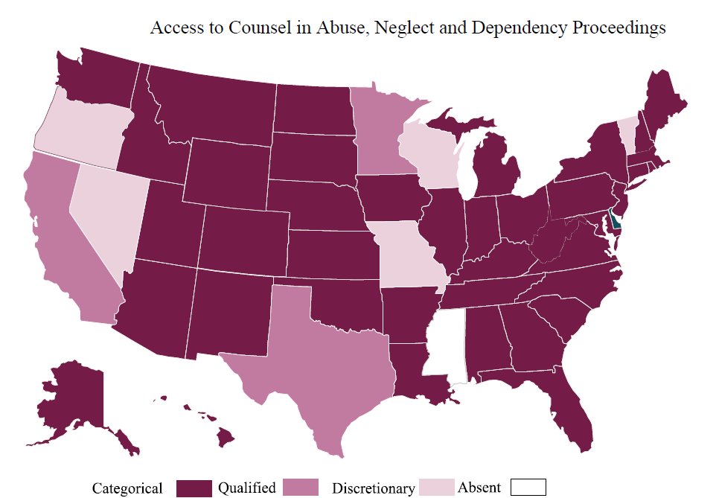
Source: National Coalition for a Civil Right to Counsel, 2013. Status Map. http://www.civilrighttocounsel.org/map

Slide 7
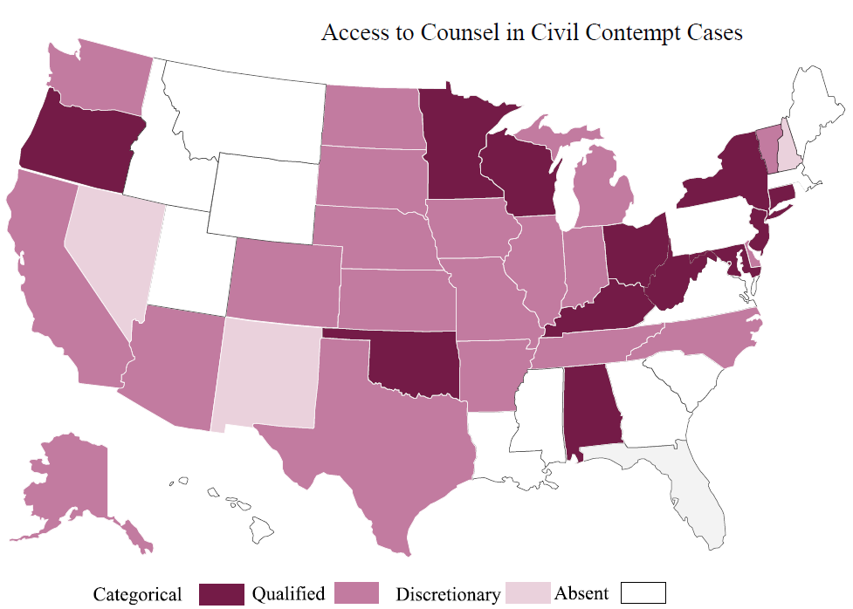
Source: National Coalition for a Civil Right to Counsel, 2013. Status Map. http://www.civilrighttocounsel.org/map

Slide 8
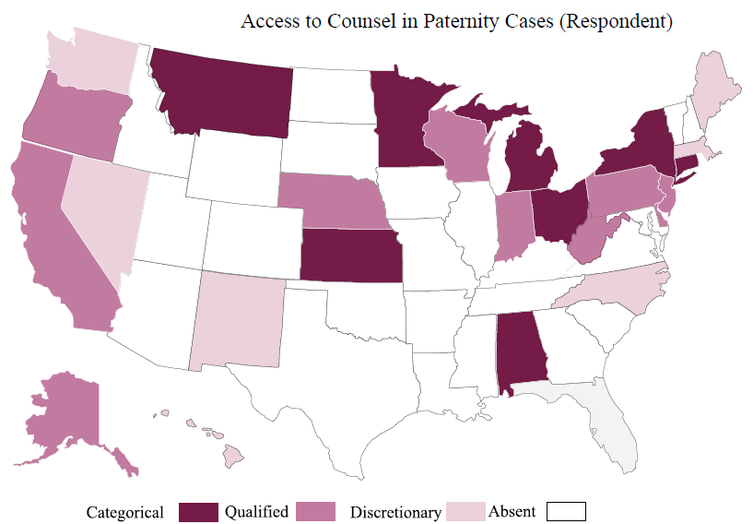
Source: National Coalition for a Civil Right to Counsel, 2013. Status Map. http://www.civilrighttocounsel.org/map

Slide 9
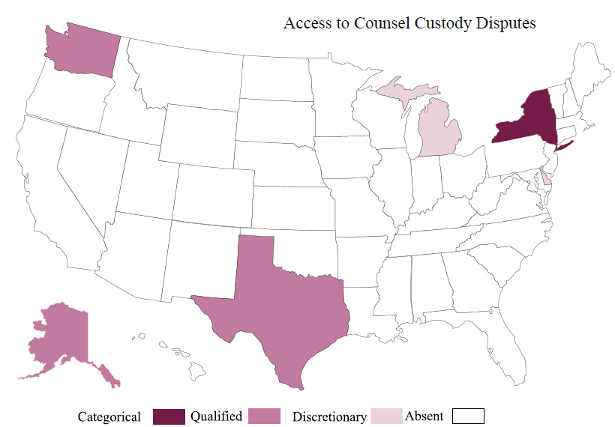
Source: National Coalition for a Civil Right to Counsel, 2013. Status Map. http://www.civilrighttocounsel.org/map

Slide 10
Theoretical Explanations for State Counsel Policies
Resource dependency: Levels of funding available to state
Demand: Size of disadvantaged population
Political culture: Public attitudes toward disadvantaged populations
Welfare policy climate: State post-TANF rules for public assistance
Indigent defense policy climate: State generosity in funding criminal defense

Slide 11
Results of OLS Regression Hypothesis Tests
Parent Right to Counsel Index B Beta
State revenue per capita - .072 - .078
Disadvantaged population per capita - .290 - .237*
Public attitudes toward the poor .250 .200
Welfare climate .169 .138
Indigent defense climate .081 .289*
r2=.210

Slide 12
The Case of Upstate New York: Caseloads and Costs
State law: Access to counsel statutorily provided in
Termination of parental rights Abuse and neglect
Family offenses (both parties) Divorce
Custody disputes Child support violation
Adoption Paternity
How is representation provided in New York Family Court?
How many Family Court cases involve assignment of counsel?
What accounts for lower, higher indigent defense family court caseloads?

Slide 13
Comparison of Family and Criminal Caseloads
Family Court Representation (2012) min max mean
Total Family Court filings 99 27941 4459
Family Court filings per 1000 population 10 56 30
Indigent defense Family Court cases 28 8661 1815
Ratio of defense program cases to filings 11% 98% 34%
Indigent defense Family cases per 1000 2 38 11
Indigent defense criminal cases per 1000 10 47 26

Slide 14
Results of OLS Regression Hypothesis Tests
Public Defense Family Caseload per capita B Beta
Family Court caseload per capita .050 .031
Local indigent defense expenditures per capita 1.621 .392**
Local social services expenditures per capita .050 .369**
Percent population white 1.037 .409**
r2=.474

Slide 15
Summary
Extreme variation in state policies on civil right to counsel in family cases
Variation not readily explained by conventional policy explanations
Where access to counsel is expansive, the ‘demand’ for counsel in family cases approaches current criminal court caseloads
Family court caseloads associated with public defense climate and welfare climate at the county level

